Slide 1
🛡️Implementing a Secure Framework for a Code Review Tool (SCRF)

Slide 2
Project Overview
Problem Statement
⚠️
Software applications often contain:
Security vulnerabilities
Coding errors
Hardcoded secrets
Vulnerable third-party libraries
Poor coding practices
Manual code review is time-consuming and may miss critical security issues.

Slide 3

Solution
The Secure Code Review Framework (SCRF) automates code review by integrating multiple open-source security tools into a single platform.
The framework:
Performs automated static code analysis
Detects security vulnerabilities
Generates remediation guidance
Tracks compliance with OWASP, SANS, and CERT standards
Provides interactive dashboards and reports

Slide 4
🎯Project Goal
To develop a secure, scalable, and automated code review framework that improves software quality and strengthens application security while reducing manual effort.

Slide 5
🎯 Primary Objective
Develop a secure, automated code review framework that detects vulnerabilities, improves code quality, and supports secure software development.
📋Key Objectives
🛡️ Integrate multiple static code analysis tools
🔍 Detect security vulnerabilities and coding errors
📚 Apply OWASP, SANS, and CERT security standards
💡 Provide remediation guidance with secure coding examples
🔗 Integrate with version control systems for automated reviews
👥 Implement secure authentication and Role-Based Access Control (RBAC)
📊 Generate dashboards, reports, and compliance tracking
⚡ Optimize scanning performance for large projects

Slide 6
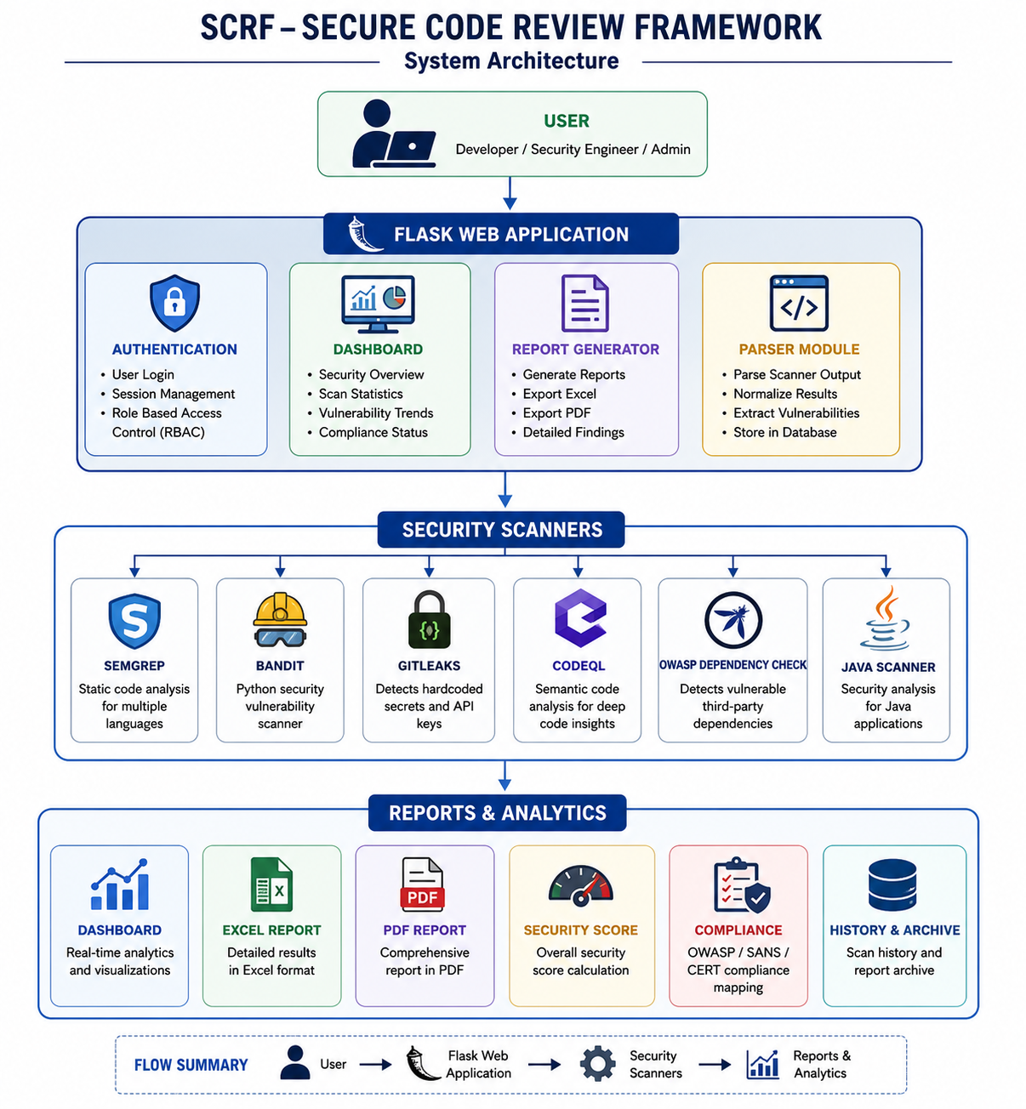
🏗️ Framework Architecture

Slide 7
💻 Technology Stack
🛡️ Security Scanners
Frontend
HTML5
CSS3
JavaScript
Chart.js
Backend
Python 3
Flask
🛡️ SonarQube Community Edition
🔍 Semgrep
🐍 Bandit
🧠 CodeQL
🔑 GitLeaks
📦 OWASP Dependency-Check
☕ Java Scanner

Slide 8
Reports & Analytics Development Tools
PDF Reports
Excel Reports
Dashboard Analytics
Compliance Metrics
Visual Studio Code
Git
Docker (if used during development)
Windows 11

Slide 9
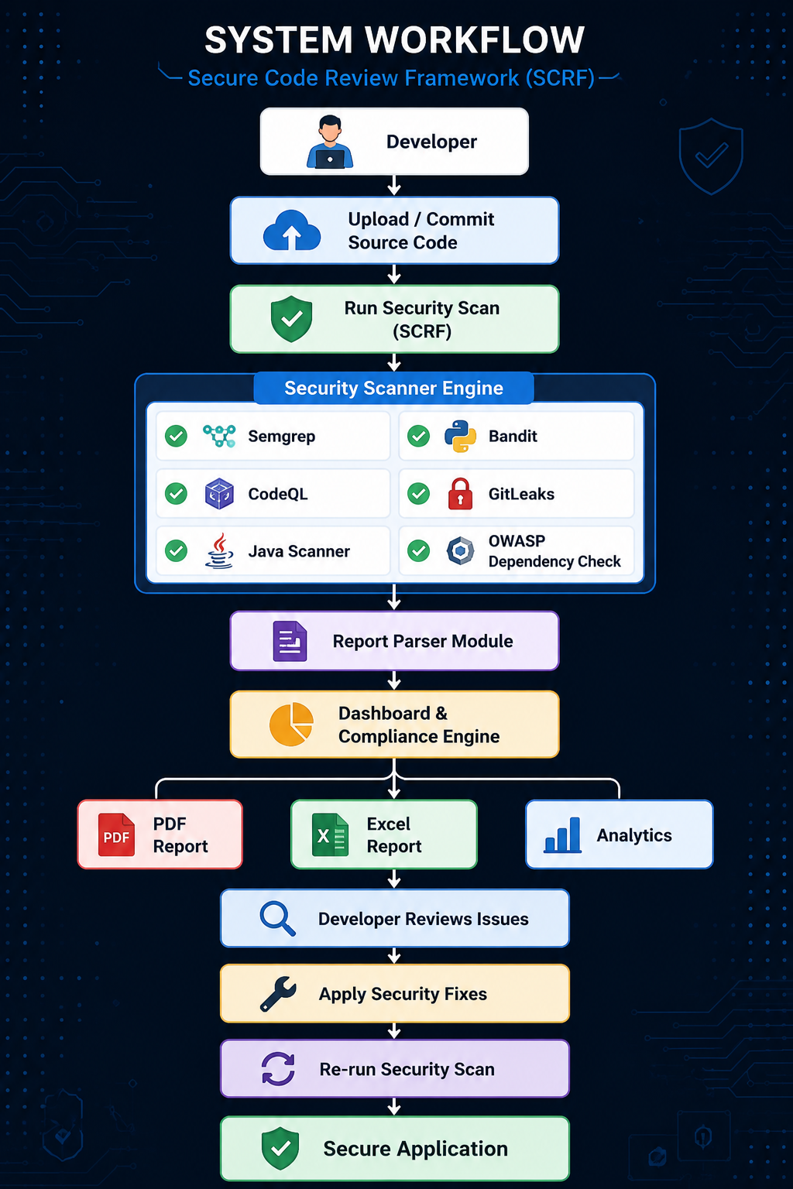
🔄 System Workflow
🎯 Key Workflow Steps
Developer uploads source code.
SCRF starts automated scanning.
Multiple security scanners analyze the code.
Reports are parsed and combined.
Dashboard updates automatically.
PDF and Excel reports are generated.
Developer fixes vulnerabilities.
Code is scanned again for verification.

Slide 10
🛡️ Security Scanners & Their Roles
Tools
Purpose
SonarQube
Semgrep
Bandit
CodeQL
GitLeaks
OWASP Dependency-Check
Java Scanner
Detects code quality issues, bugs, vulnerabilities, and code smells
Finds insecure coding patterns using customizable security rules.
Identifies security issues in Python source code.
Performs semantic analysis to discover complex security vulnerabilities.
Detects exposed secrets, API keys, and passwords in Git repositories.
Identifies vulnerable third-party libraries using CVE databases.
Detects Java-specific security issues and coding errors.

Slide 11
🎯 Security Scanners & Their Roles Benefits
Automated vulnerability detection
Multi-language support
Secure coding compliance
Early detection of security risks
Detailed vulnerability reports
Improved software quality

Slide 12
🖥️ SCRF Dashboard Features
📊 Security Score
🚨 Total Vulnerabilities
📅 Last Scan Details
⚡ Scanner Status
📈 Scanner Analytics
📉 Severity Distribution
📋 Vulnerability Report Table
🔍 Search & Filter
📄 PDF & Excel Export
🛡️ Compliance Dashboard
📂 Git Repository Information
📜 Live Scan Log

Slide 13
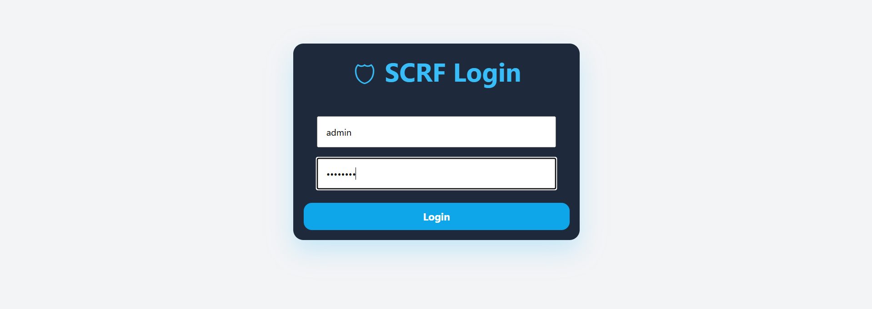
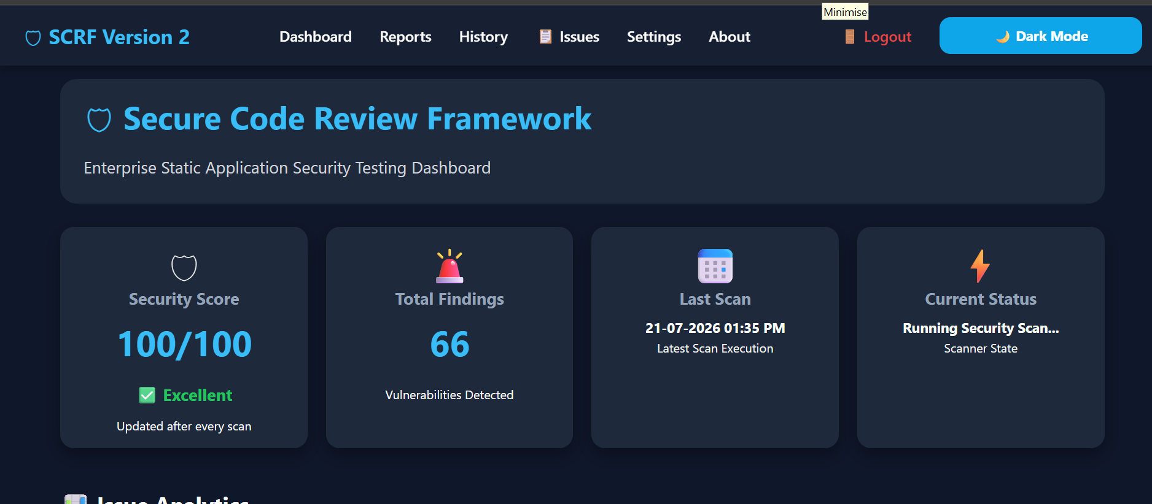
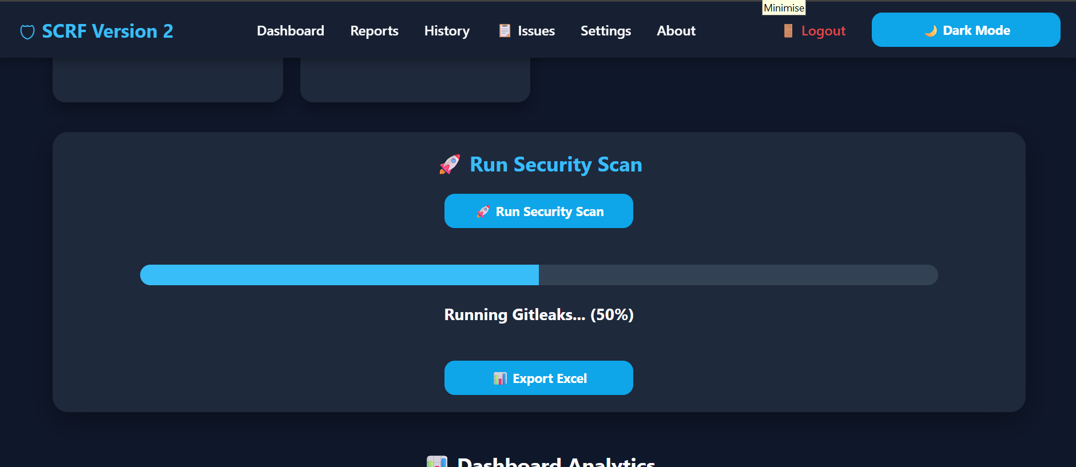
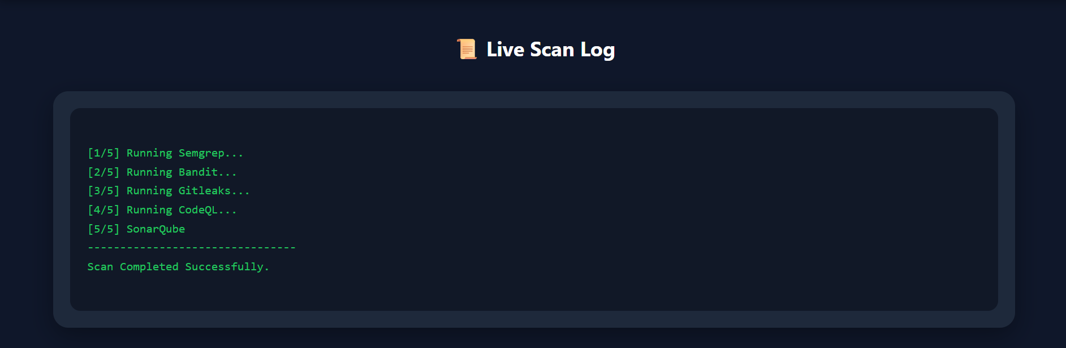
Screenshot Of Dashboard

Slide 14
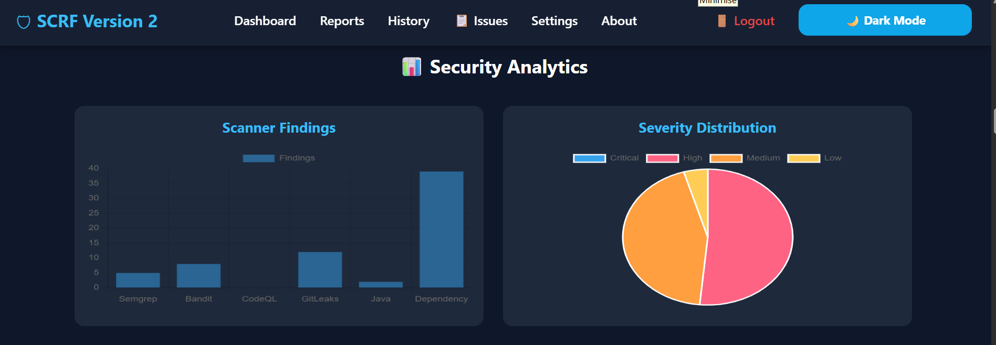
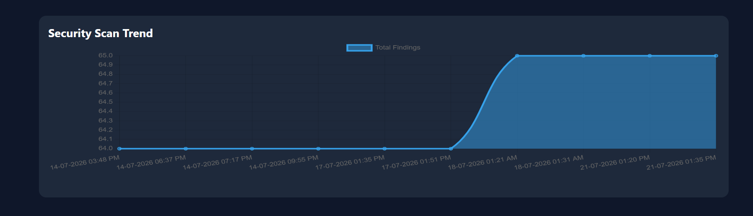
Screenshot of charts

Slide 15
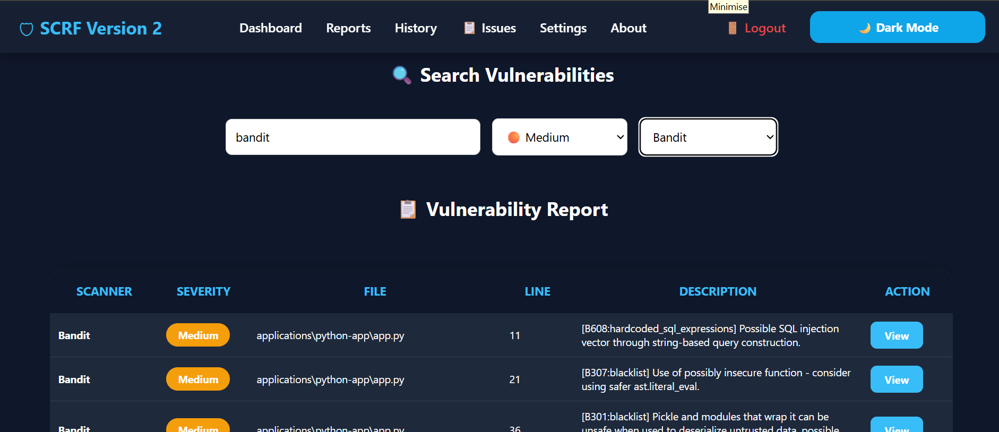
Screenshot of vulnerability reports

Slide 16
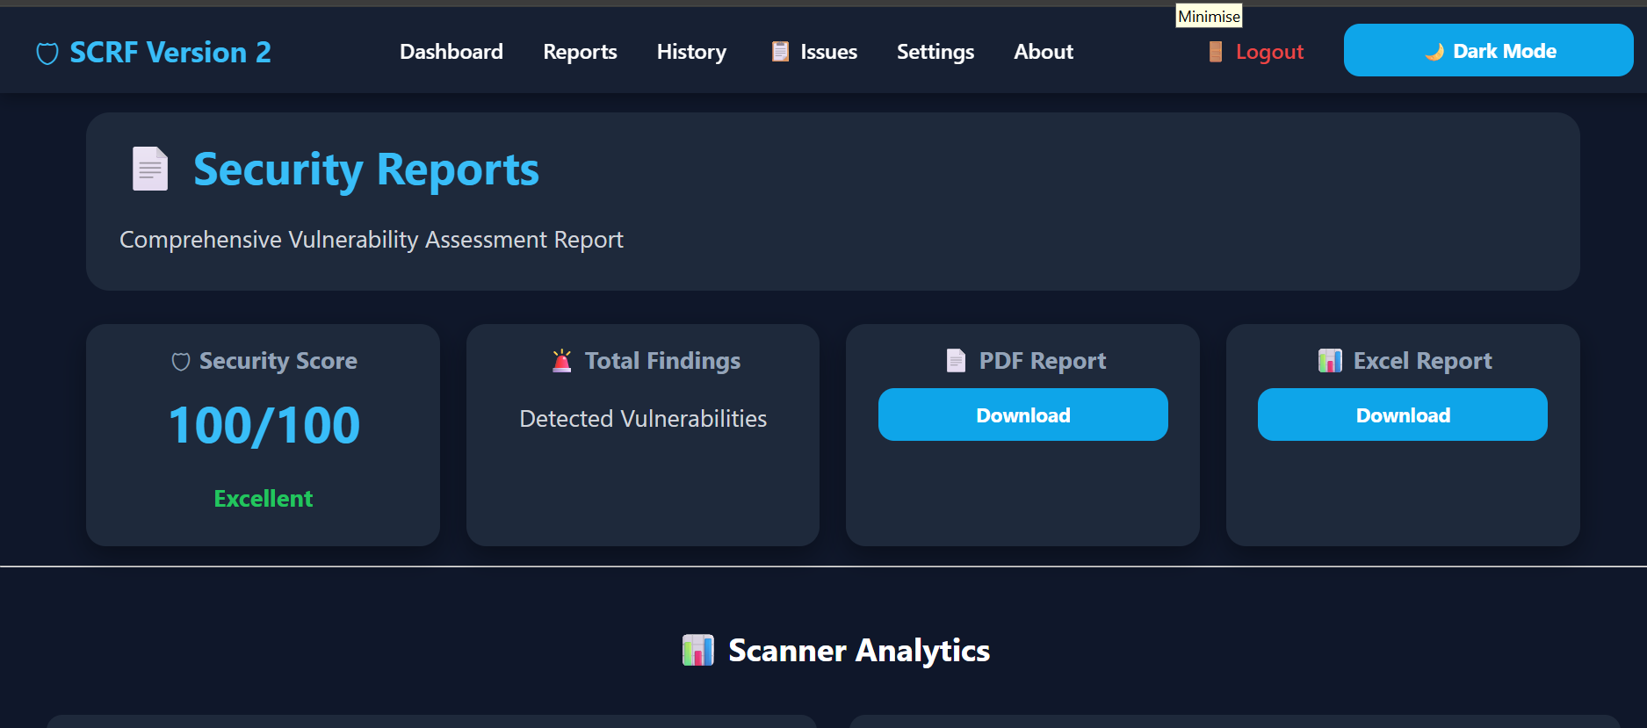
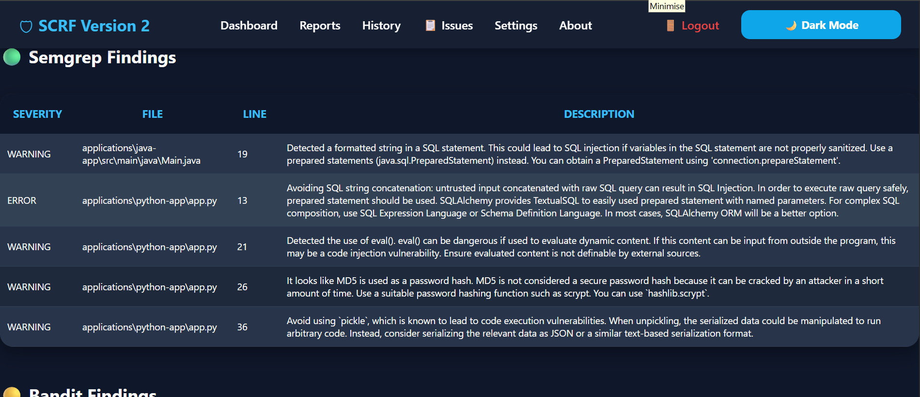
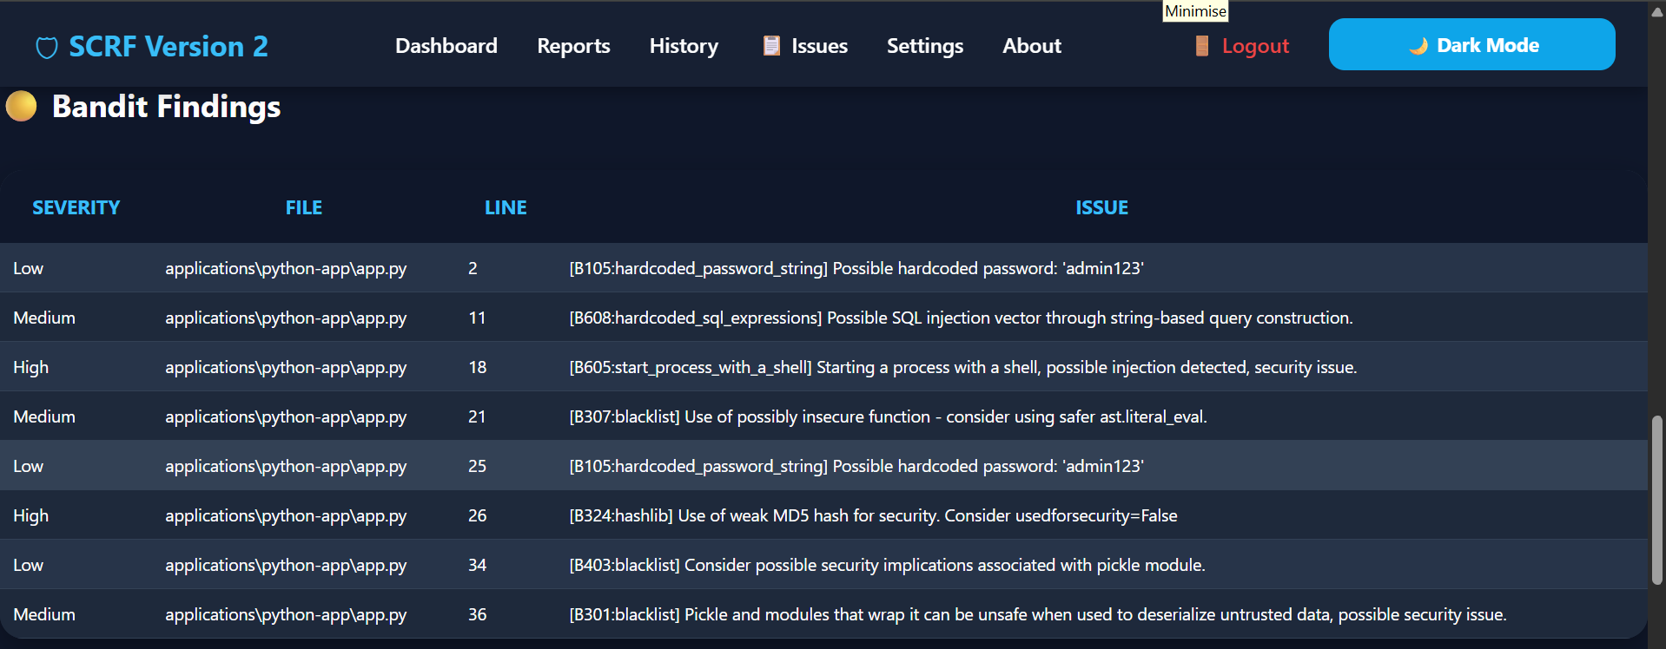
Screenshot of security reports

Slide 17
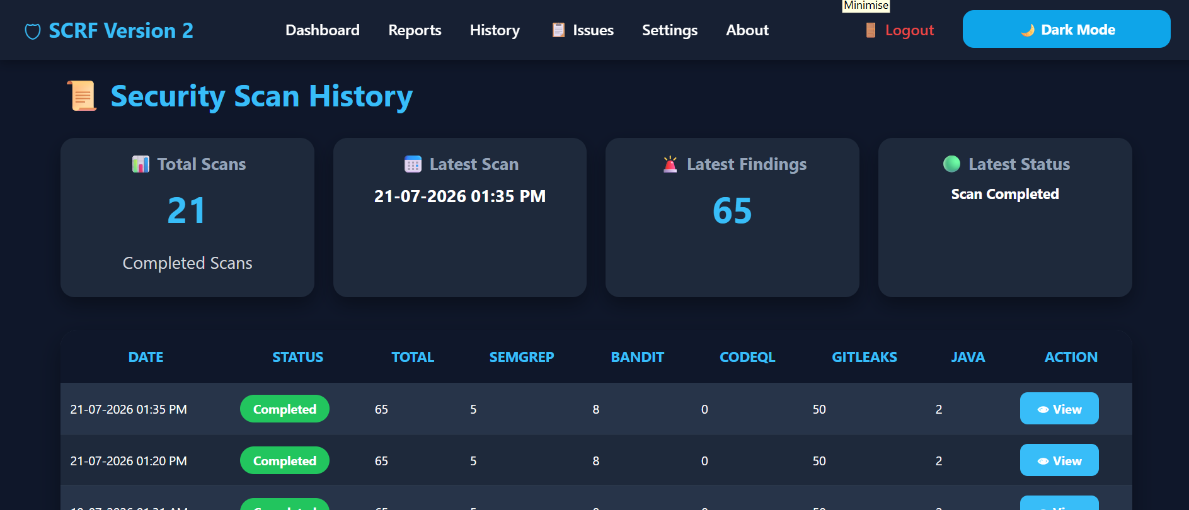
Screenshot of security scan history

Slide 18
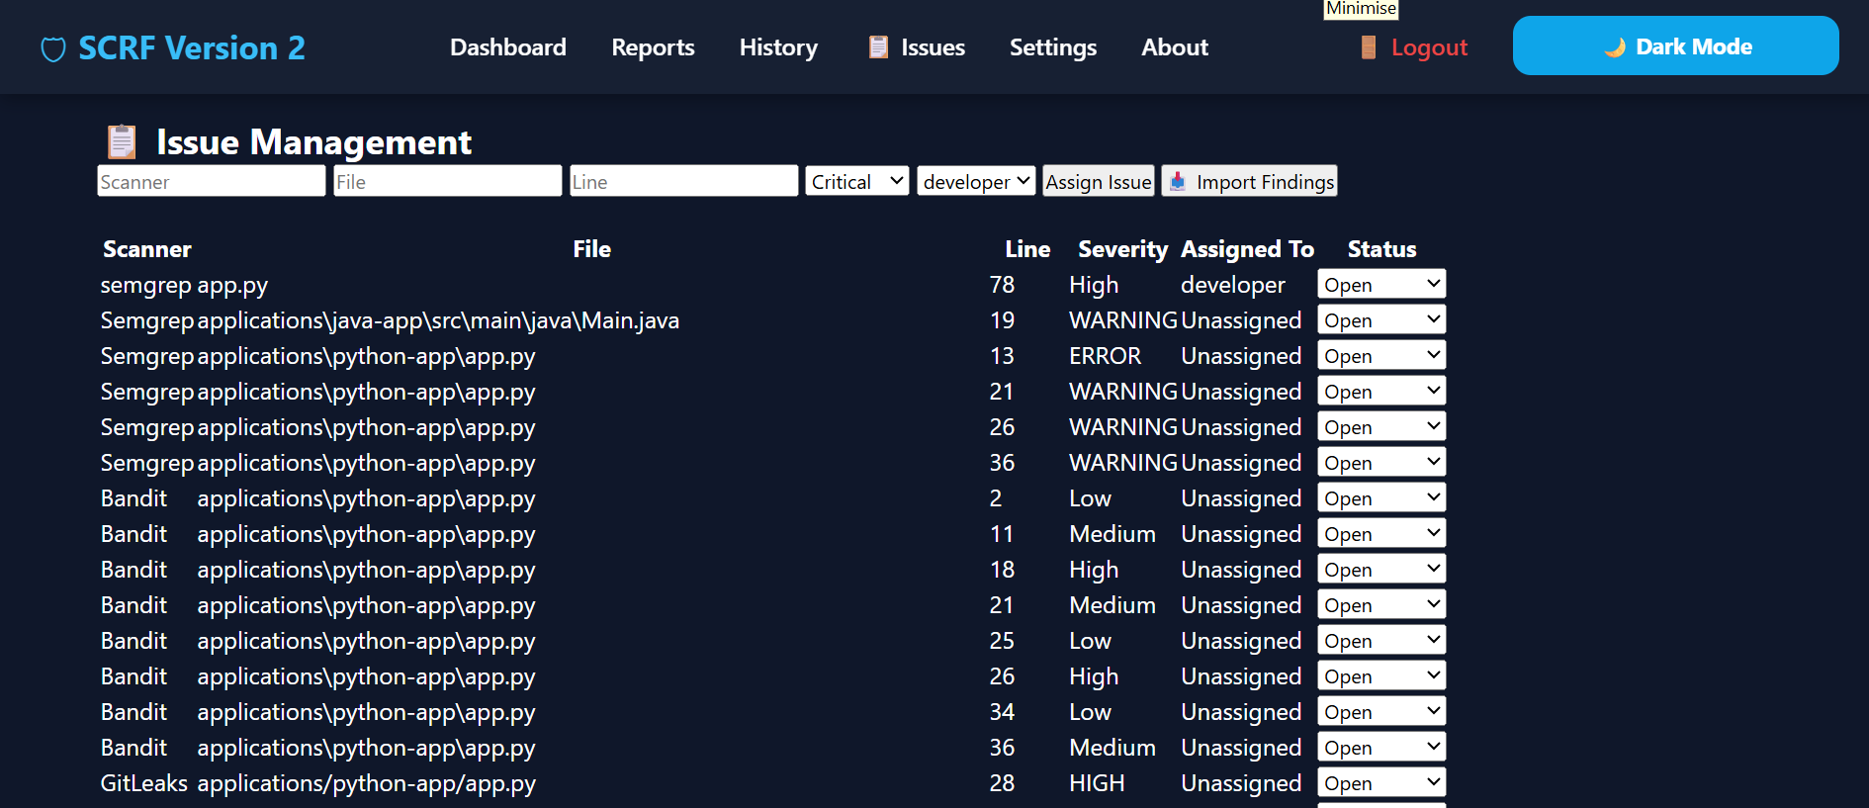
Screenshot Of Issue Management

Slide 19
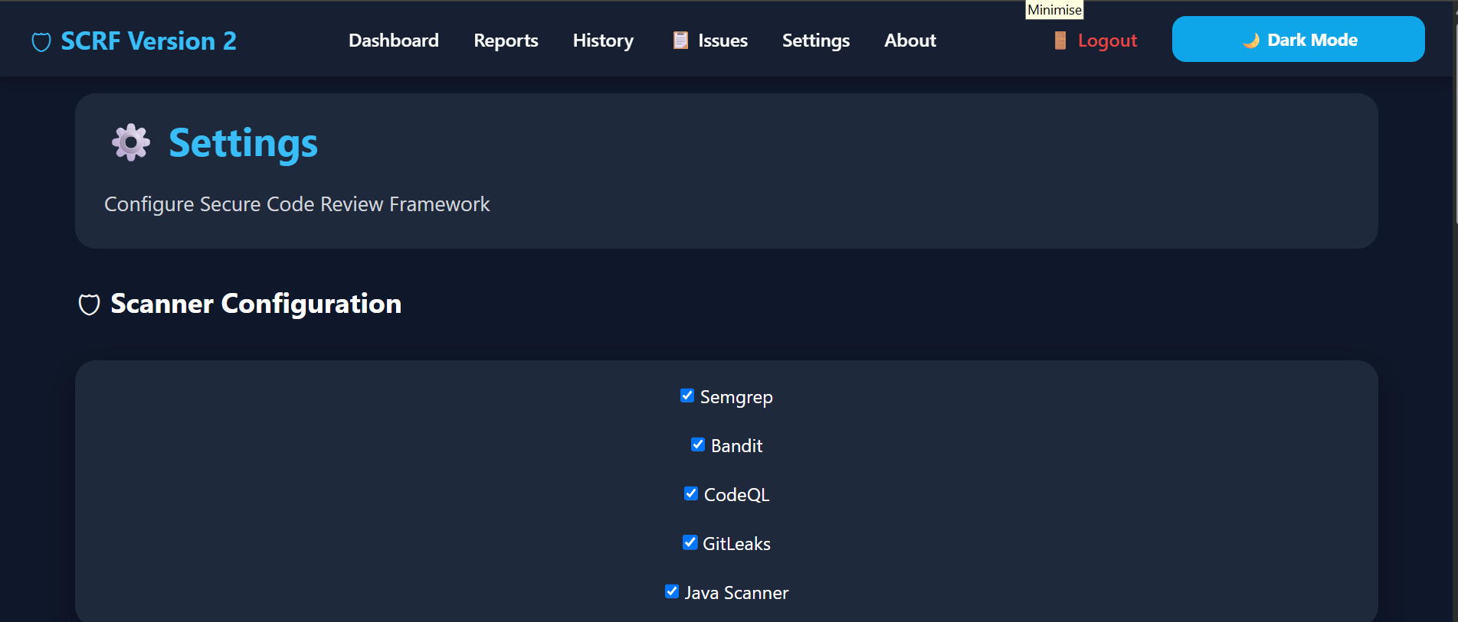
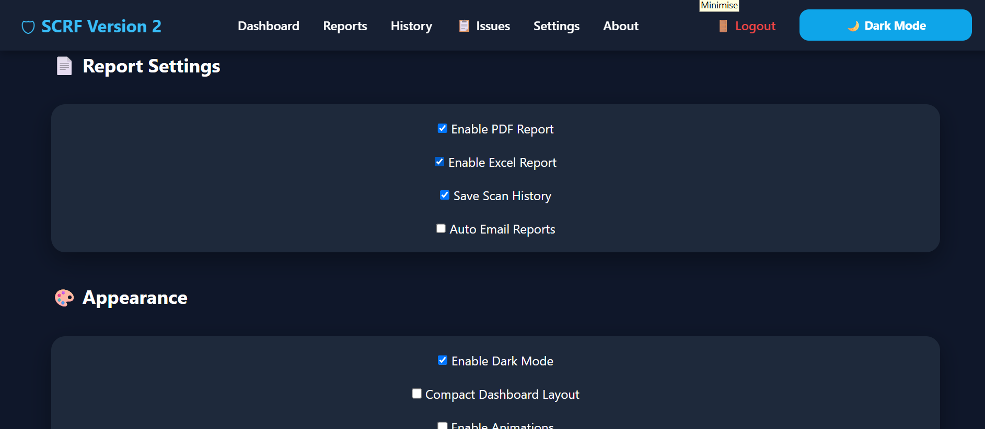
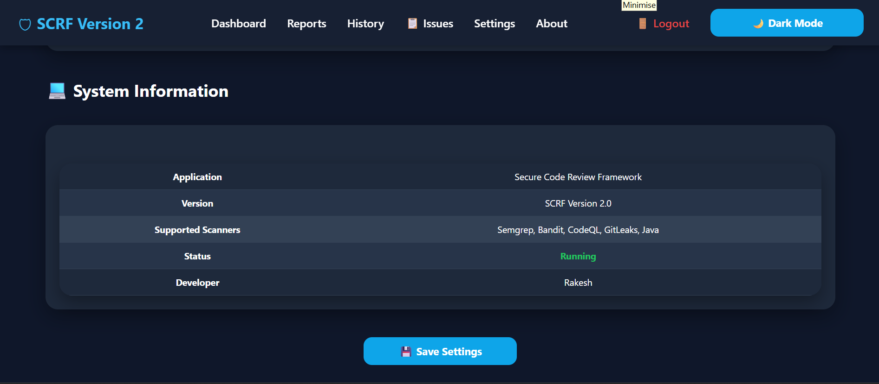
Screenshot Of Settings

Slide 20
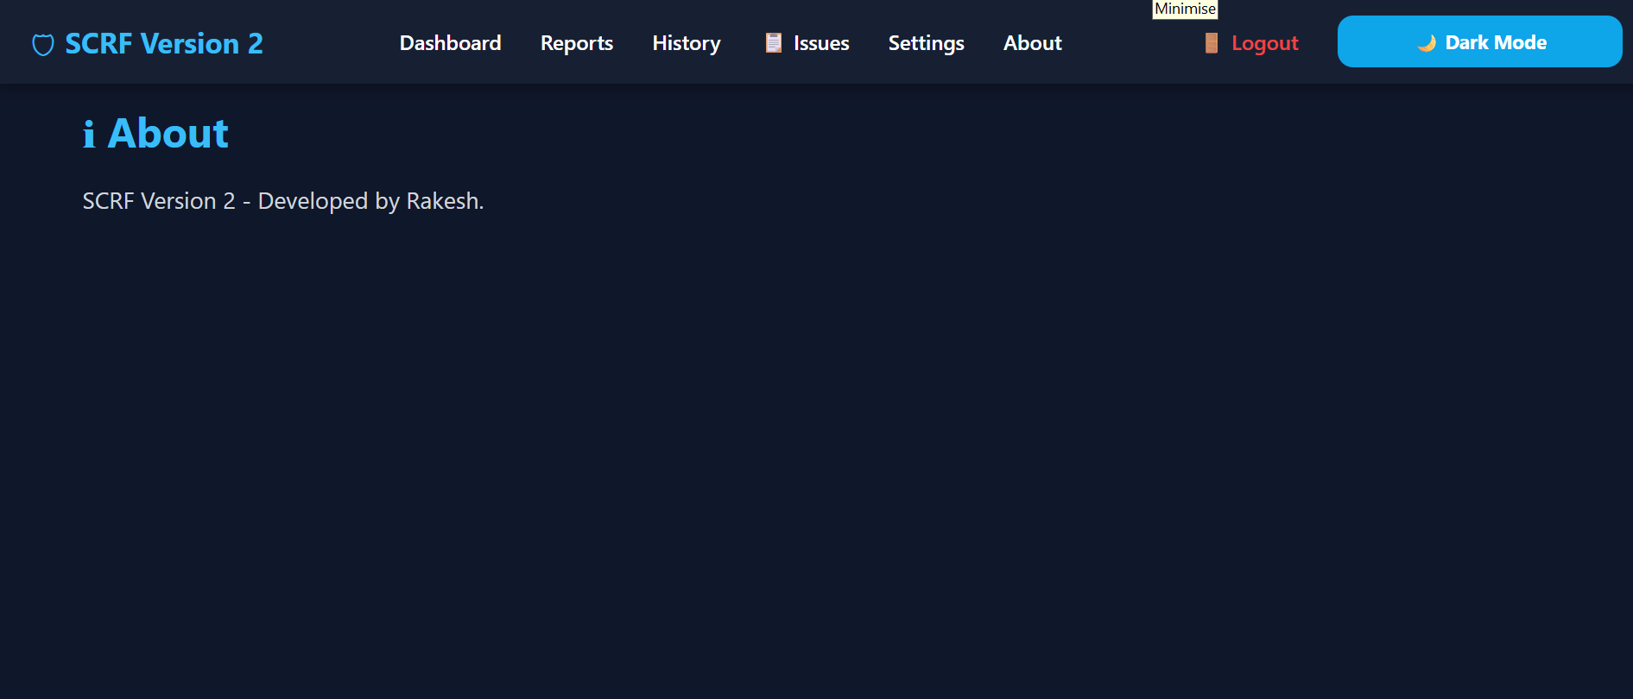
Screenshots Of About

Slide 21
THANK YOU

